Slide 1
High-speed imaging
Claus-Dieter Ohl

Slide 2
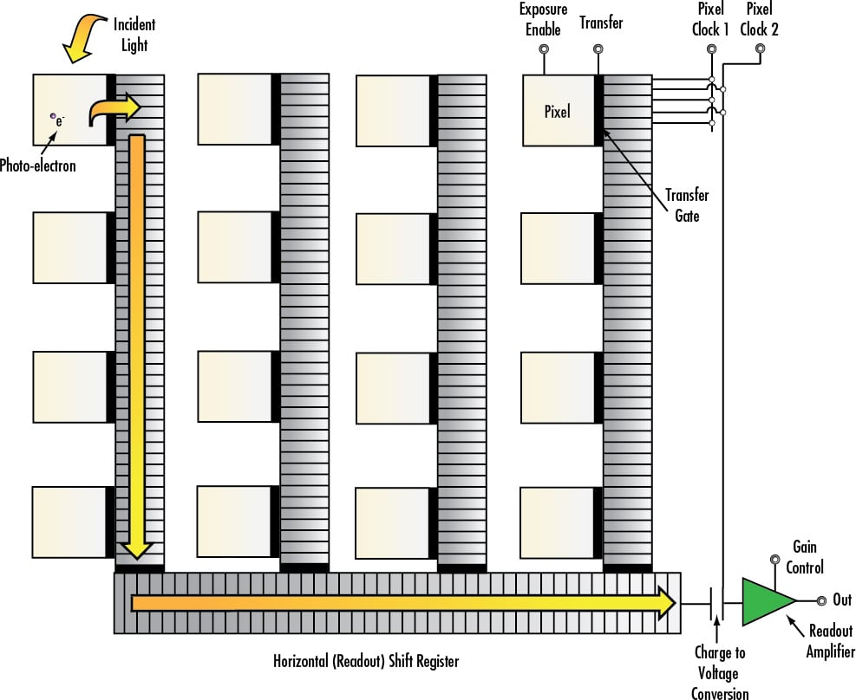
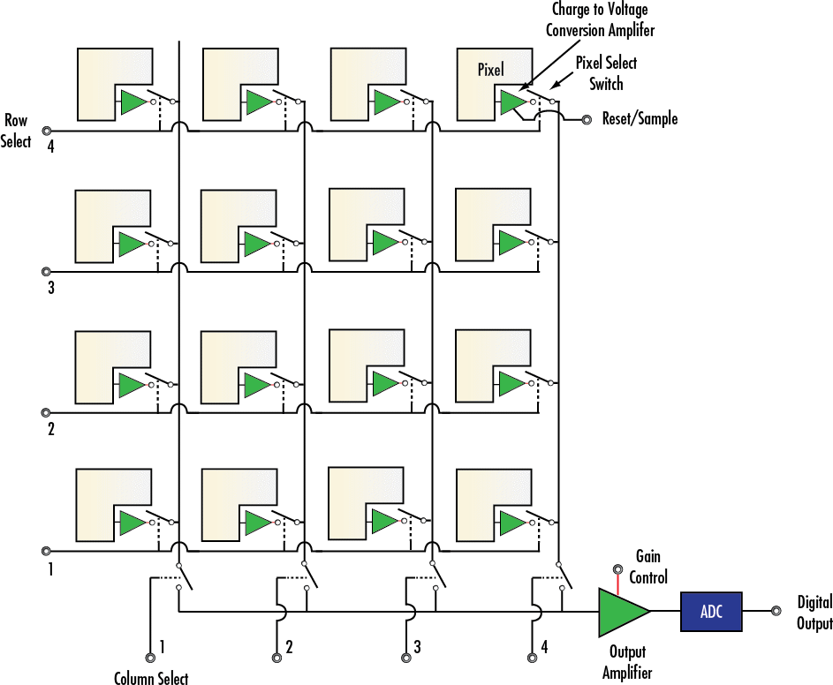
CCD vs. CMOS sensors

Slide 3
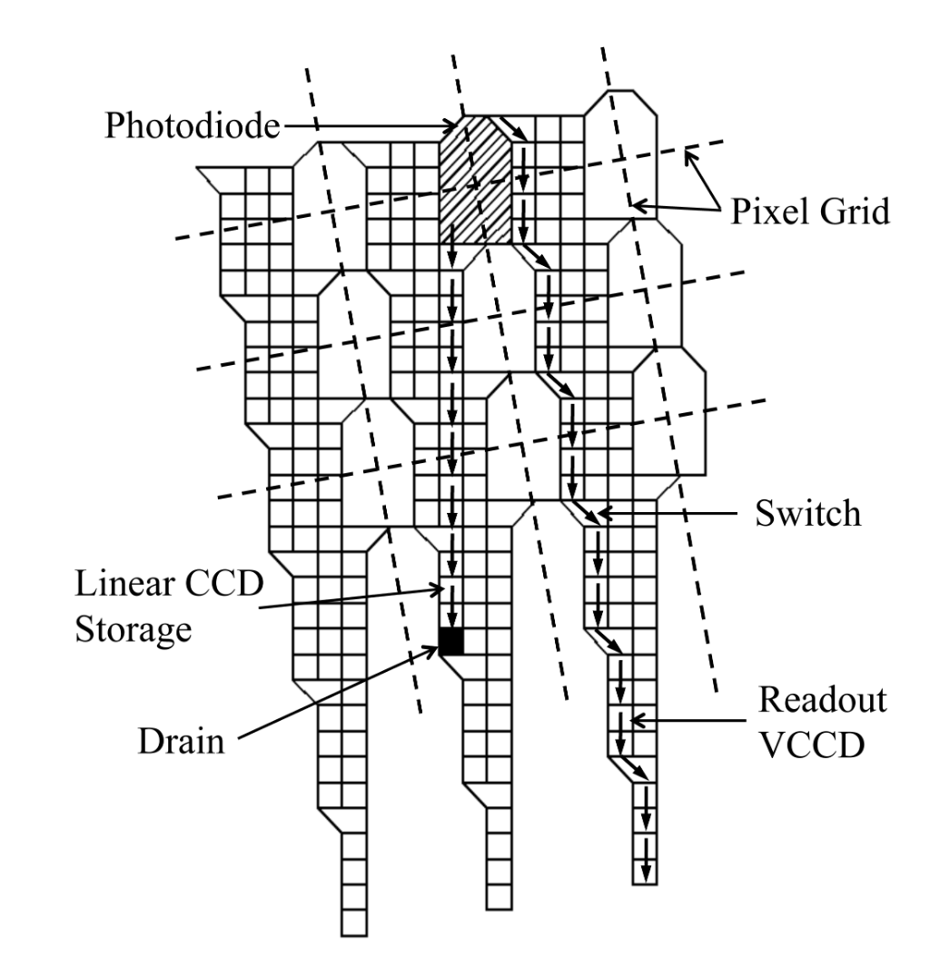
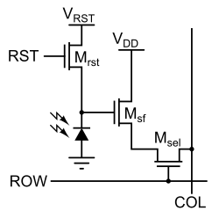
Single CMOS pixels
Storage CCD sensor
of the Shimadzu HPV 1
https://en.wikipedia.org/wiki/Active-pixel_sensor

Slide 4
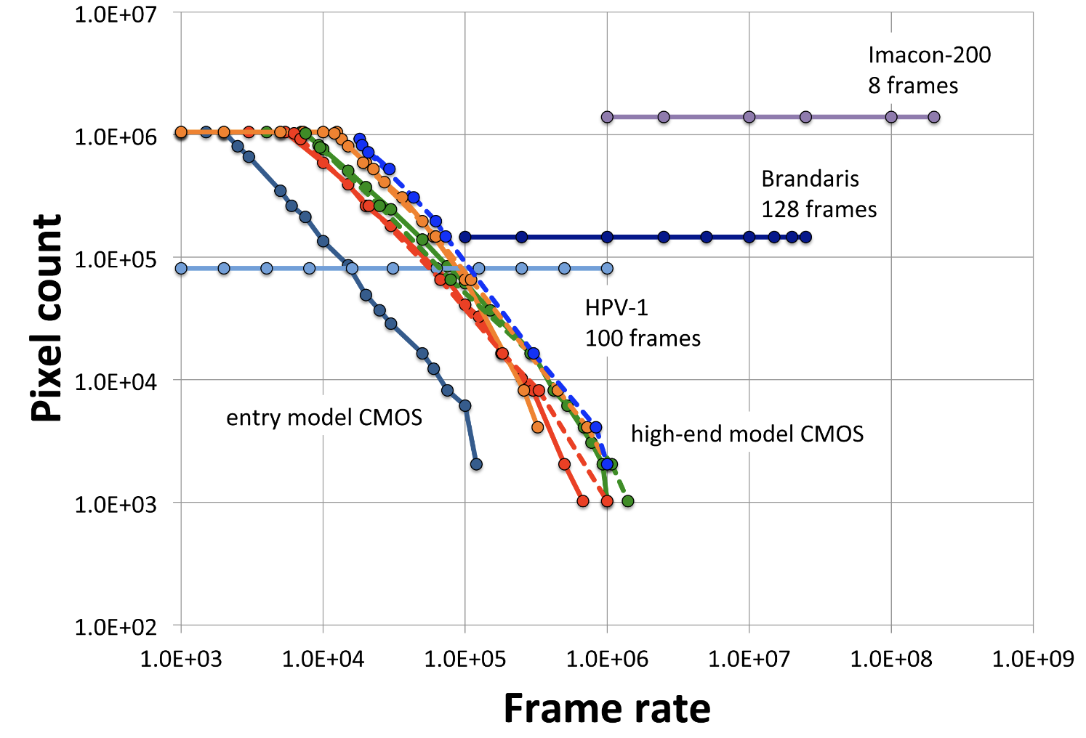
Full frame, CMOS and single image cameras
HPV X-2
128 frames
Pharsighted
continous imaging
M. Versluis, Exp. Fluids (2013)

Slide 5
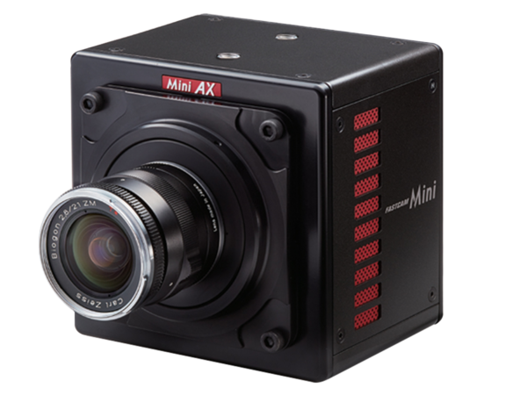
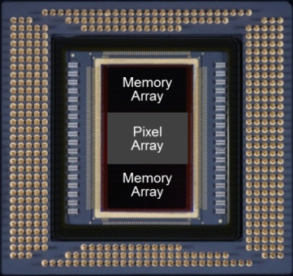
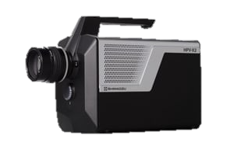
CMOS based high-speed cameras
Off-sensor memory
On-sensor memory
Photron Mini AX200:
Up to 900,000 frames/s
Shimadzu HPV X-2
Up to 10 million frames/s

Slide 6
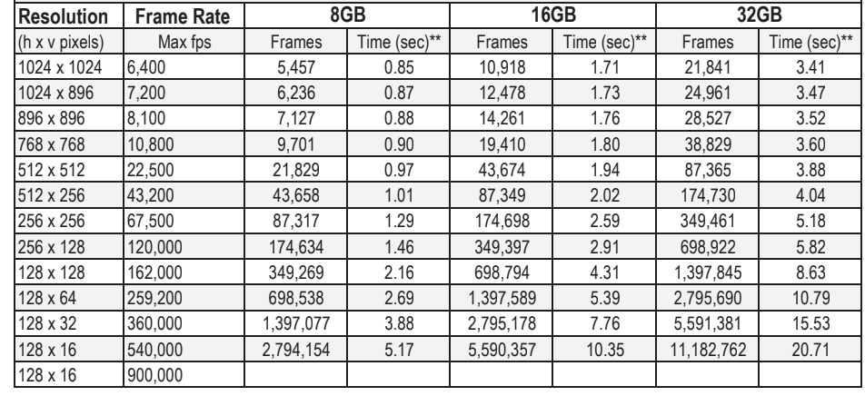
Framing rate off sensor memory camera (Mini AX200)
Framing rate limited by pixel clock and number of ADC converters

Slide 7
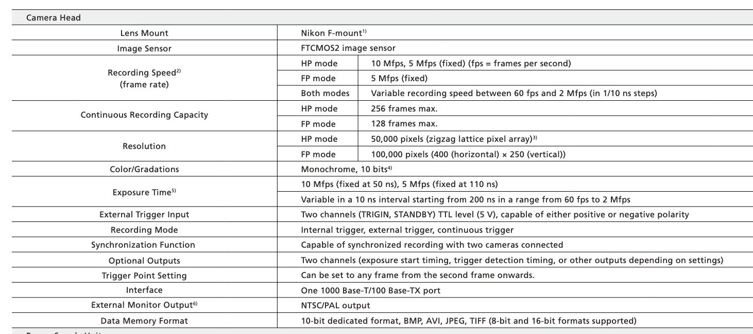
Shimadzu HPV X-2

Slide 8
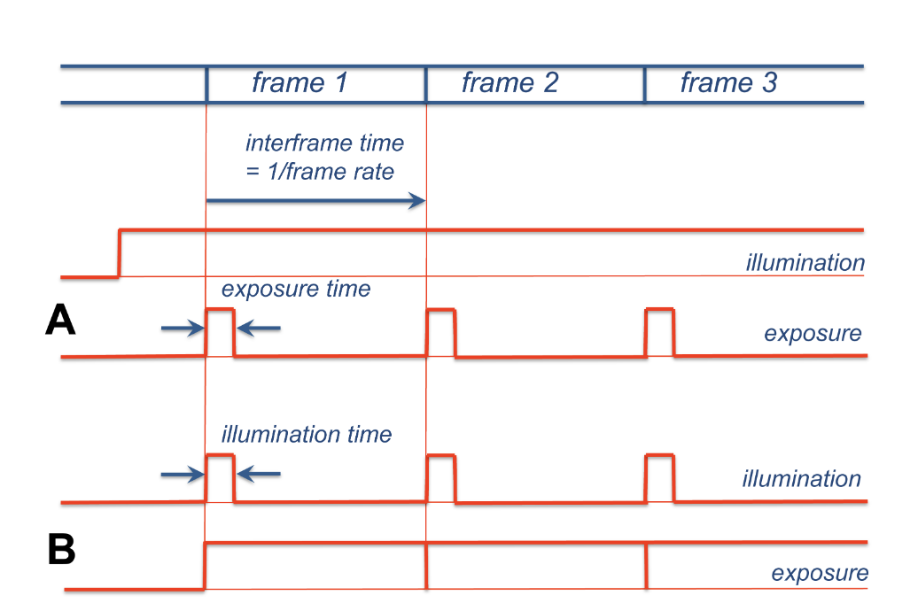
Exposure control
Camera controls illumination
Light source controls illumination

Slide 9
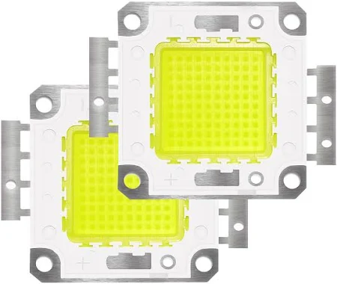
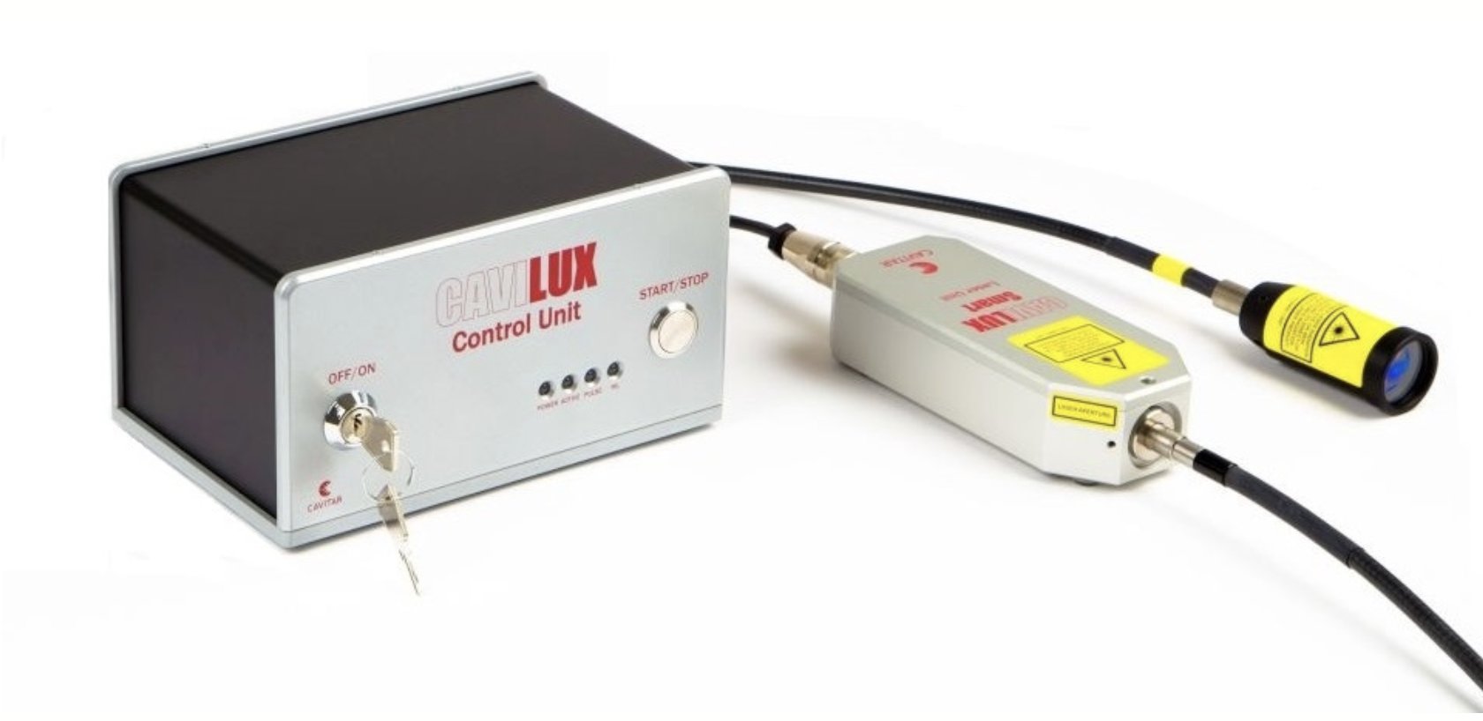
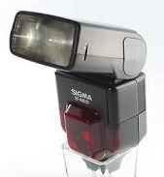
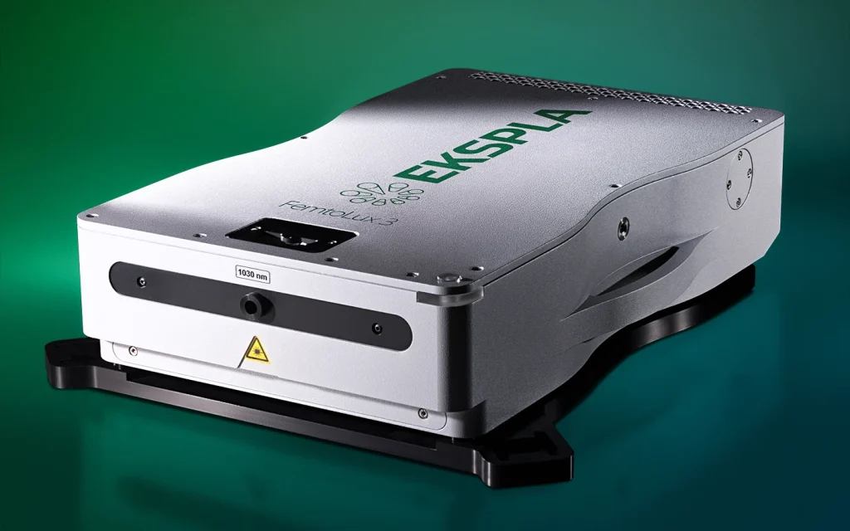
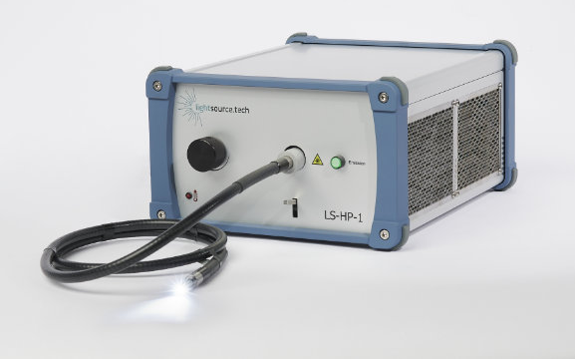
Light Sources
Pulsed laser diode based light source
Pulse duration about 10ns
LED up to 100W
electrical power
fs and ps high repetition rate lasers, coupled into
multimode glass fiber up to 10MHz
LED based light source
Light transmitted through liquid light guide
Cheap option photo strobe

Slide 10
Kind of illumination
Diffuse illumination
Shadowgraphy

